Slide 1


Chapter 4
Software Defined Network
(SDN)
Rami Tawil

Slide 2
What is Software-Defined Networking?
“Software defined” becomes a very popular
    Software defined networking,
    Software defined storage,
    Software defined radio, etc.
What is it?
  The control of the underlying system is exposed to the upper layer developer through an API.
  System functionality is implemented over the API as an app (software).
  This allows customization for what users want.
Another word for “Software defined” is “Programmable”

Slide 3
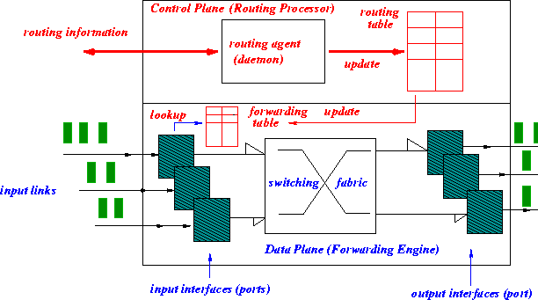
Today’s router: control plane and data plane

Slide 4
Today’s router
Tightly coupled data and control plane
Hardware vendors also provide proprietary control software
monolithic router contains switching hardware, runs proprietary implementation of Internet standard protocols (IP, RIP, IS-IS, OSPF, BGP) in proprietary router OS (e.g., Cisco IOS)

Slide 5

Today’s network
Individual routing algorithm components in each and every router interact with each other in control plane to compute forwarding tables
Routing
Algorithm
control
plane
data
plane

Slide 6
Today’s network
Equipment vendors provide a set of routing (network control) choices: OSPF, RIP, ISIS, BGP, etc.
Network control using a distributed, per router approach.
Network administrator can change network parameters to achieve certain objectives: e.g. changing routes
  Limited programmability
  If one wants a new control mechanism (e.g. new routing services for data centers), (s)he is out of luck.
  This is what SDN tries to overcome: making the network control like an API that user can develop by themselves.
  SDN is to make network control more programmable, easier to deploy new services.

Slide 7
SDN motivation
Why do we want to make network control more programmable?
  Short term:
      Existing network control is no longer sufficient in several important areas, need innovation here!
          Data centers, Wireless, network security
      Existing network control is getting too complicated.
          Too many middleboxes with their own control
          Would be nice to provide a unified mechanism to deploy and manage these middleboxes
  Long term:
      Programmability promotes innovation; and innovation is good for the networking industry.

Slide 8
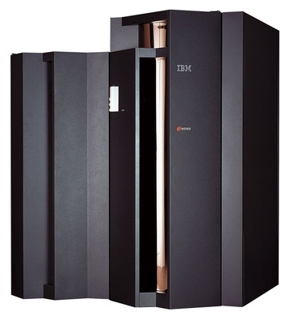
Computing systems once upon a time
Vertically integrated systems
    Proprietary hardware
    Proprietary OS
    Proprietary applications
    Highly reliable
  Dominated by a small number of large companies (IBM, HP, etc)
      Slow software innovation
          Proprietary development
      Small industry

Slide 9
Computing Systems Today
Open interfaces
Fast innovation
    Everyone can participate
Industry
  Software is now part of everything.
To promote innovation, we must make network systems like this!
App
App
App
App
App
App
App
App
App
App
App
Open Interface
Windows
(OS)
Linux
Mac
OS
or
or
Open Interface
Microprocessor
Microprocessor

Slide 10
Traditional vs. SDN Architecture
Traditional Network
Distributed control plane
Proprietary interfaces
Static configuration
Vendor lock-in
Complex management
SDN Network
Centralized control plane
Open, standard interfaces
Dynamic programmability
Vendor neutrality
Simplified management

Slide 11
SDN Key Principles
Centralized Control: Global network view and decision making
Programmability: Software-defined network behavior
Abstraction: Applications independent of hardware details
Openness: Vendor-neutral and standards-based

Slide 12
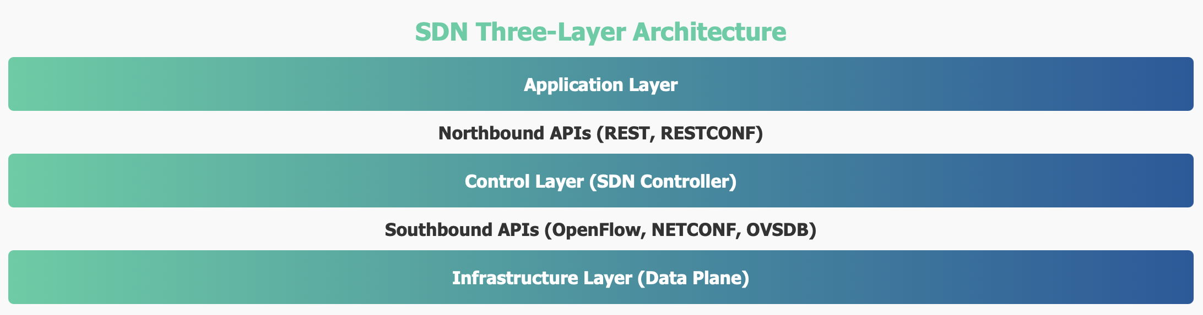
SDN Architecture
SDN Architectural Components
  Application Layer
  Control Layer
  Infrastructure Layer
  Southbound and Northbound APIs

Slide 13
SDN Architecture
Layer Responsibilities
Application Layer: Business logic, network services, applications
Control Layer: Network intelligence, policy enforcement, orchestration
Infrastructure Layer: Packet forwarding, switching, routing hardware
API Functions
Northbound APIs: Controller-to-application communication
Southbound APIs: Controller-to-infrastructure communication
Eastbound/Westbound: Inter-controller communication

Slide 14
Control Plane vs Data Plane
Plane Separation Concept
  SDN fundamentally separates the control plane (network intelligence) from the data plane (packet forwarding), enabling centralized control and programmable network behavior.
Plane Comparison
Aspect | Control Plane | Data Plane
Function | Network intelligence & decisions | Packet forwarding & processing
Location | Centralized controller | Distributed switches/routers
Processing | Control messages, topology | User data packets
Performance | Scalability focused | Throughput & latency focused
Programmability | Highly programmable | Hardware-optimized

Slide 15
Control Plane vs Data Plane
Benefits of Separation
Control Plane Benefits:
Global network view
Centralized policy enforcement
Simplified network management
Rapid service deployment
Vendor independence
Data Plane Benefits:
Hardware-optimized forwarding
High throughput performance
Low latency packet processing
Simplified switch design
Cost-effective infrastructure

Slide 16
SDN Controllers
Controller Functions
Network View: Maintain global topology and state
Policy Enforcement: Implement network policies
Flow Management: Install and manage flow rules
Application Interface: Provide northbound APIs
Popular SDN Controllers
Open Source Controllers
OpenDaylight: Java-based, modular
ONOS: Carrier-grade, high availability
Floodlight: Simple, REST APIs
Ryu: Python-based, component architecture
Commercial Controllers
Cisco APIC: Application Policy Infrastructure
VMware NSX: Network virtualization
Juniper Contrail: Virtual networking
Big Switch Big Cloud Fabric: Data center

Slide 17
SDN Controllers
Controller Architecture Patterns
Centralized: Single controller instance
Hierarchical: Master-slave controller relationships
Distributed: Multiple coordinated controllers
Federated: Inter-domain controller cooperation

Slide 18
Northbound APIs
Northbound API Purpose
Northbound APIs provide programmable interfaces between SDN controllers and applications, enabling network services and business logic implementation.
Common Northbound Interfaces
REST APIs:
HTTP-based CRUD operations
JSON/XML data exchange
Stateless communication
Easy integration with web applications
Intent-Based APIs:
High-level policy specification
Business logic abstraction
Declarative network configuration
Automated policy translation
Network Programming Languages:
Frenetic: Functional reactive programming
Pyretic: Python-based DSL
NetKAT: Network Kleene Algebra with Tests
P4: Programming Protocol-Independent Packets

Slide 19
Northbound APIs
Intent-Based Networking
High-level policy expression
Automated implementation
Business-driven networking
Simplified configuration
API Examples
Network topology discovery
Flow rule installation
Traffic engineering
Security policy enforcement
Quality of service management

Slide 20
SDN Benefits
Centralized Control
Global network view and intelligence
Simplified network management
Consistent policy enforcement
Reduced configuration complexity
Agility and Innovation
Rapid service deployment
Network programmability
Faster time-to-market
Dynamic resource allocation
Cost Reduction
Commodity hardware utilization
Reduced operational expenses
Efficient resource utilization
Simplified network architecture
Flexibility
Vendor-independent solutions
Open standards adoption
Multi-vendor interoperability
Future-proof architecture
Innovation: Enables new network services and business models
Business Impact
Scalability: Supports growth and changing requirements
Automation: Reduces manual tasks and human errors

Slide 21
SDN Implementation Challenges
Technical Challenges
Controller Scalability: Performance bottlenecks and scaling limits
Network Latency: Controller communication overhead
Reliability: Single point of failure concerns
Security: Centralized attack surface
Operational Challenges
Migration Complexity:
Legacy system integration
Gradual transition planning
Skill set transformation
Process re-engineering
Tool and platform changes
Performance Considerations:
Controller placement optimization
Flow setup latency
Reactive vs. proactive approaches
Network-wide consistency
Fault tolerance mechanisms

